Slide 1

Working with Git and GitHub

Slide 2
Working with Git and GitHub
Instructor: Brandon Reyes
Website: www.rc.colorado.edu
Helpdesk: rc-help@colorado.edu

Slide 3


My Goal
Learning Goals
Convince you that basic Git/GitHub fluency is:
Easy
Practical
An extremely important tool in your tool belt!
Understand the basics of version control
Differences between Git, GitHub
Basic Git fluency
How to collaborate with Git

Slide 4
Outline
Brief overview of Git and GitHub
What is version control?
Creating your own repository locally
Pushing local changes to GitHub
Collaboration

Slide 5
Have you set up Git/GitHub?
This is meant to be a mostly hands on tutorial. If you haven’t yet, you may still be able to get everything set up in time on CURC resources:
https://github.com/ResearchComputing/intro_to_git_github_fall_23#gitgithub-homework

Slide 6
Git vs GitHub
Git: version control system
the actual software
GitHub: Cloud-based storage website
Hosts repositories (“repos”)
Provides a GUI for many Git features
Allows for easy collaboration
Issues, pull requests
GitHub basic is free (up to 5GB of storage)
GitHub Enterprise (free for CU affiliates)
https://oit.colorado.edu/services/business-services/github-enterprise

Slide 7
What is version control?
Version control is the practice of tracking and managing changes to files.
Why do I need it?
Revert to various states of files
You can think of this as a backup
Allows you to modify items without harming the original copy
Not limited to code
documents, images, etc…

Slide 8

Additional benefits of version control
Using version control provides
Clear tracking of the repo’s history
Management and view of different branches (work)
Collaboration through merging of branches
Main
Images: nobledesktop.com

Slide 9


Different Version Control Systems
Subversion (svn)
Mercurial
CVS
etx
We’re going to stick to Git
industry standard
widely known
most resources
Images from Wikipedia

Slide 10
Getting Started with Git
(local)

Slide 11
Setting Git up locally
Many systems have Git installed; however, you may need to download it on your local machine
See https://git-scm.com/book/en/v2/Getting-Started-Installing-Git for more information
Today I am going to stick with using Git on a CURC login node

Slide 12
Logging into RC via a Terminal
To login to an RC login node:
$ ssh <username>@login.rc.colorado.edu
Supply your IdentiKey password and your Duo app will alert you to confirm the login
Confirm Git has been configured (by you using the README)
$ git config --list

Slide 13
Hands on tutorial
Goal: Create a simple project that contains a markdown file
First let’s create a new directory for our project:
$ cd /projects/$USER
$ mkdir git-tutorial
$ cd git-tutotial

Slide 14
Git Repository (Repo)
A Git repository tracks and saves the history of all changes made.
All of this information is stored in “.git”, which is the repository folder
We can make a directory (folder) a Git repo using “git init”

Slide 15
Git Init
In your “git-tutorial” directory run
$ git init
Git creates the "hidden" directory called “.git”
$ ls –a
Your directory is now a repo!
Git is now ready to to be used
Allows us to tell Git what items to watch

Slide 16
Create the main branch
Now that we have a repo, we can create branches. Branches are a version of the repository.
It is customary to name the primary branch “main”
This can be done as follows (after an init)
$ git checkout –b main
You can switch between branches
$ git checkout <branch-name>
Main

Slide 17
Let’s add a file!
It is customary to add a README.md
Description of repo and any helpful information
To add a README.md, in “git-tutorial” create and edit the file using nano (or an editor of your choice)
$ nano README.md
Add anything you would like!
Be sure to save the file when you exit.

Slide 18




Git does not know about README.md yet!!

Slide 19
Areas of Git Workflow
Working Area
Items that you are currently working on
Are not tracked by Git!
Exists locally
Staging Area
When Git starts tracking and saving your work
Exists locally
Items are added to this area by using “git add”
Snapshot Area
All staged items are captured
Version of the repo
Exists locally
Items are added to this area by using “git commit”
GitHub
Exists locally and on GitHub!
Items are added to this area using “git push”

Slide 20
Git Status
The git status command displays the state of the working and staging area.
Let’s see what area README.md is in
$ git status
We see it is an untracked file, so it is in the working area

Slide 21
What if you don’t want Git to track something?

Slide 22
.gitignore
We can add a file named “.gitignore” to our repo
Specifies what items (files, directories, etc.) should never be tracked
Let’s create a file to ignore!
$ echo "Super secret stuff" > confidential_data.txt
Add “.gitignore” to “git-tutorial” and put “confidential_data.txt” in it
$ echo confidential_data.txt > .gitignore

Slide 23
Let’s add our files to the staging area now!

Slide 24
Git Add
The git add command adds a change in the working area to the staging area
Let’s add our README.md to the staging area
$ git add README.md
or add everything in the current directory
$ git add .
Anytime a change is made, you need to do a git add (to track them)
Working Area
Staging Area
Snapshot Area
GitHub
git add

Slide 25
Git Commit
The git commit command captures a snapshot of all staged items
Commits can be thought of as a version of the repo
Commits should be accompanied with a brief message
Let’s commit our staged item!
$ git commit -m ‘Create repo, add README.md, add .gitignore’
$ git status
Working Area
Staging Area
Snapshot Area
GitHub
git add
git commit

Slide 26
Common practice – add, commit
git add
Can be performed as much as you want
Doesn’t need to be done after every change
git commit
Always include a comment!!
Bundle common staged items together
Try not to put too many things in a commit

Slide 27
Git Log
The command git log lists the commits made in that repository
Lists the most recent commits first
$ git log

Slide 28
All changes and files are only locally stored right now!

Slide 29
To GitHub we go!

Slide 30
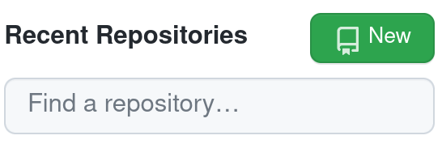
GitHub
When you first create a repo locally, you will need to setup a new repository on GitHub too
Go to https://github.com
Sign in
Click on “Create New Repository” or just “New”

Slide 31
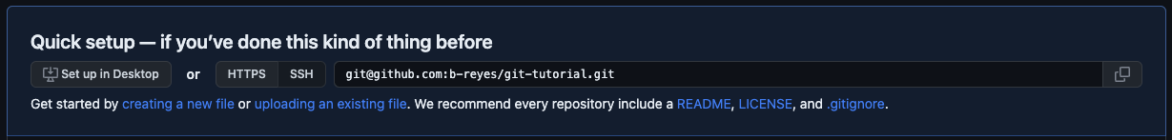
Create Repo in GitHub
Name your repo, I chose “git-tutorial”
Don’t add a README or a .gitignore
Click “Create repository”
We have set everything up in the previous slides, we only need to copy the ssh link!

Slide 32
Linking local repo to GitHub repo

Slide 33
Git Remote
Used to identify the remote (e.g. GitHub) repos are linked to your local repo
Used to link remote repos to your local repo
To view currently linked remote repos:
$ git remote -v
To link our remote repository:
$ git remote add origin git@github.com:<user>/git-tutorial.git

Slide 34
Sending local changes to GitHub

Slide 35
Git Push
Uploads local repository content to a remote repository
Pushing is how you transfer commits from your local repo to a remote repo
$ git push <name of remote repo> <branch>
$ git push origin main
Working Area
Staging Area
Snapshot Area
GitHub
git add
git commit
git push

Slide 36
GitHub
Go back to GitHub and refresh your page
should see the files we have added (and not the ones we’ve ignored)
Some cool features!
look at our commits
directly edit/commit in the browser
Let’s do that! Let’s something and commit it on GitHub
But now our remote repo is one commit ahead of our local one…

Slide 37
Git Fetch & Merge
Git fetch retrieves the changes from the remote repo
$ git fetch
Git merge combines two branches
$ git merge origin/main
There’s an easier way!

Slide 38
Git Pull
Git pull combines the fetch and merge commands
$ git pull <name of remote repo> <branch>
$ git pull origin main
IMPORTANT!
Make sure no commits have been done on local branch
It is fine to have staged items (git add)
ALWAYS do git pull before any commits!

Slide 39
Advanced topic (time permitting): Collaboration

Slide 40

GitHub Forks
Pull Request (PR)
Main Branch
Your Main Branch
Central Repo
(upstream)
Your Forked Repo
Fork

Slide 41

GitHub Forks
Improves collaboration
Don’t have to worry about disturbing the upstream repo
Improves transparency through pull requests
Go ahead and Fork my repo:
Go to https://github.com/b-reyes/git-tutorial
Click “Fork” button
Click “Create fork”
Creates your own version of my repo under your GitHub

Slide 42
Git Clone
Git clone makes a clone (or copy) of a remote repo in a new directory, at another location.
$ git clone <url> <optional new name>
Easy way to grab third-party code, or pre-existing code you might need to work on
$ cd /projects/$USER
$ git clone git@github.com:<user>/git-tutorial.git

Slide 43
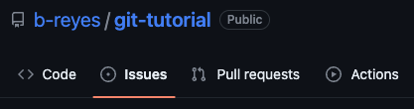
GitHub Issues
Allows you to discuss the project
Point out issues, request features, ask for help
Useful place to see past user discussion

Slide 44
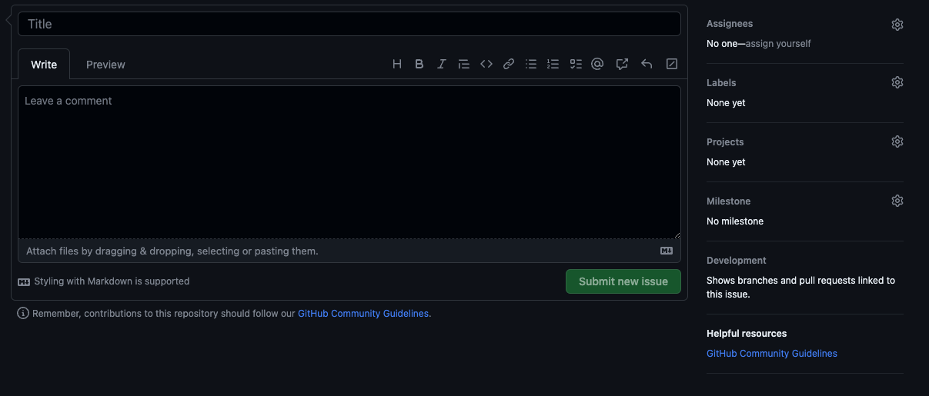
GitHub Issues
Include as much detail as possible
Version of software
Operating system
Provide a simple minimal example, if possible
If a feature request
Outline possible implementation
Highlight its value

Slide 45
Pull Requests (PRs)
A request that an upstream repo pull your branch into their branch
Starting a PR does not automatically merge changes
Notifies maintainers of upstream repo
Allows maintainers to review your changes
Discussion of changes
Requested additional changes
Maintainers of upstream repo merge in the changes

Slide 46
PR steps
Fork upstream repo
Clone the forked repo
Connect forked and cloned repo to upstream repo
Create a new branch specific to your change
Make your changes on this branch
Perform a git add, commit, and push to origin
Create a PR from GitHub
$ git remote add upstream git@github.com:b-reyes/git-tutorial.git
$ git checkout –b <new-branch> <branch-to-copy>

Slide 47
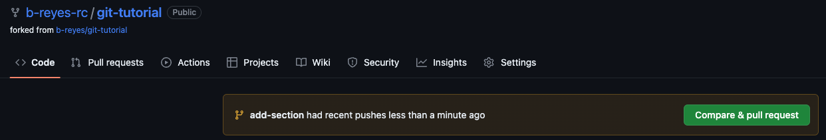
Creating a PR
After you push your changes to the forked repo, you can click the pop-up “Compare & pull request” on GitHub
Will disappear after some time

Slide 48
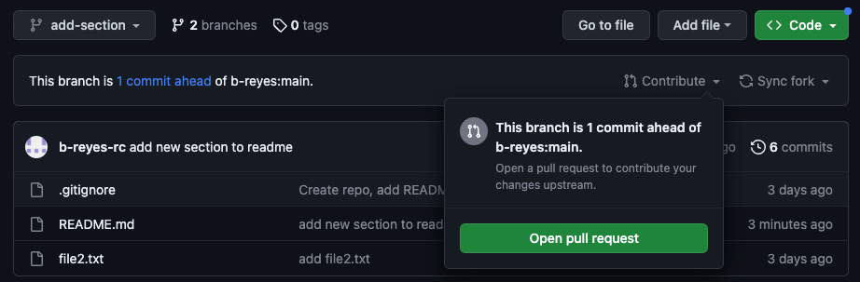
Creating a PR
After you push your changes to the forked repo
Switch to your new branch
Click the drop-down arrow next to “Contribute”
Click “Open pull request”
Will NOT disappear!

Slide 49
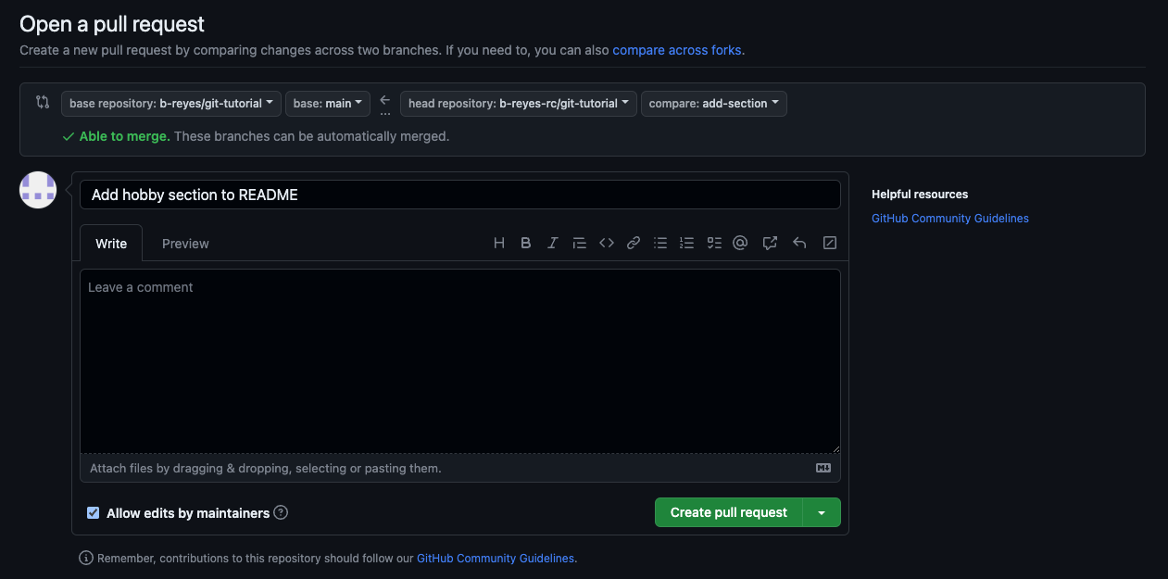
Creating a PR
Our forked repo and branch with our changes
Upstream repo and branch we want to merge into

Slide 50
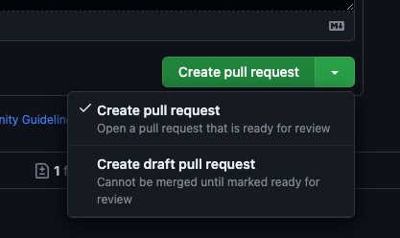
Pull Requests – Best Practice
Create a new feature branch of forked repo
When submitting a PR
Provide a short descriptive title
In comment section
Link to any current issue
Describe what the PR does and reasons for it
Draft pull requests
PR is a work in progress
Can be used for discussion

Slide 51
Merging
When doing a “git pull” you are merging in changes
This process can be done manually
When collaborating, multiple individuals can be working on the same item
Conflicts can happen!
One needs to manually resolve conflicts
Fantastic tutorial on merging:
https://www.atlassian.com/git/tutorials/using-branches/git-merge

Slide 52
Help! I’m stuck, where do I go?
Trainings with Center for Research Data and Digital Scholarship (CRDDS): https://www.colorado.edu/crdds/
Software Carpentries tutorial: https://swcarpentry.github.io/git-novice/index.html
GitHub Student Developer Pack: https://education.github.com/pack
Helpdesk: rc-help@colorado.edu

Slide 53
Thank you!!
Survey: http://tinyurl.com/curc-survey18

